Slide 1
The New Consultant Process

Slide 2
Changes
Renamed “Consultant P.O. Update” form to “Confirmation of Consultant Services” form.
Added space to record event date
NEED to attached invoice for both ONE time and MULTIPLE payments
Updated Consultant Agreement Form
Section 5:revised to include Confirmation of Consultant Services form and consultant invoice.
Consultant Agreement Process Check Off
Removed section 6: “Z- comments”
Merged instructions for one time payment with multiple payment instructions.
Pre-encumbering requisition
Removed instructions for Z comments
Made “invoice to follow” mandatory
Justification Form
Justification forms are no longer a requirement. (See below)
Procedures have been revised, only approve consultants that are called out in the school plans.

Slide 3
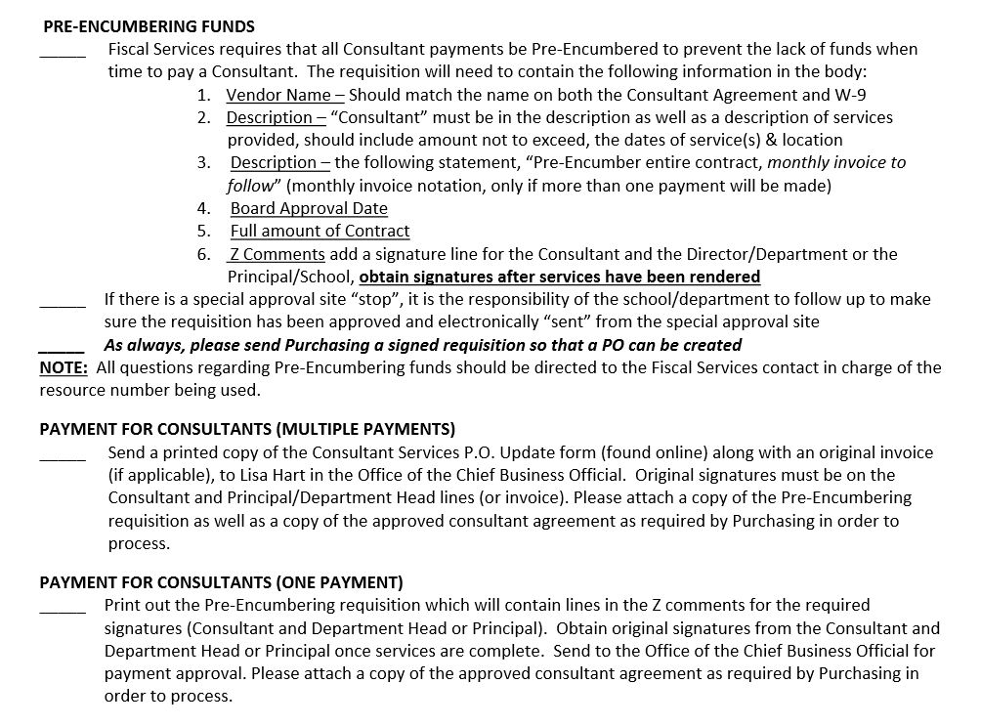
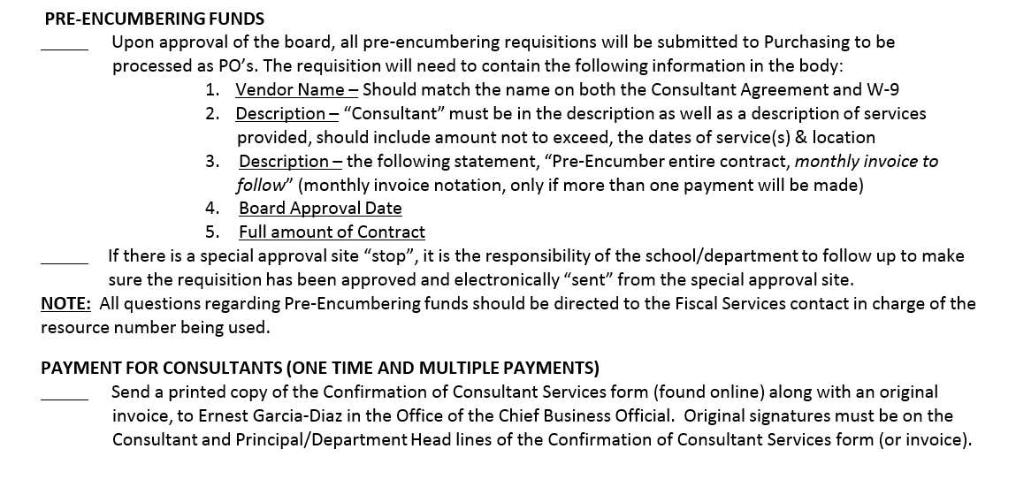
Check Off List
Previous Version
Revised 7/2015

Slide 4
Consultant Agreement
Revision 5/2015
Revision 7/2015

Slide 5
Memorandum Form
All fields must be completed for consultant packet to be processed.
Information on this form will be reviewed by the Board of Education.
“See Attached” is an unacceptable entry.

Slide 6
Requisition
Previous
New
“Invoice to follow” is now standard on all requisitions.
Removed signature lines for consultant & principal.

Slide 7
Updated Form
Consultant P.O. Update Form
Confirmation of Consultant Services

Slide 8
Invoice
Invoice Template
ALL consultants must submit an invoice
Invoice must be attached to the Confirmation of Consultant Services form.
Invoice templates are available on the CBO’s website for consultant who may not have their own invoice system.

Slide 9
Consultant Process Flow
Previous Process
New Process
Changed what the school receives
Included C.C.S. form and invoice info.
Combined steps for one time and multiple payments

